Slide 1
CHALLENGE IN DATA FOR AGRIBUSINESS FINANCE
By ODILE MUKAYIRANGA

Slide 2
Key categories in data collections.
SUPPLY-SIDE DATA
DEMAND SIDE DATA
IMPACT DATA

Slide 3
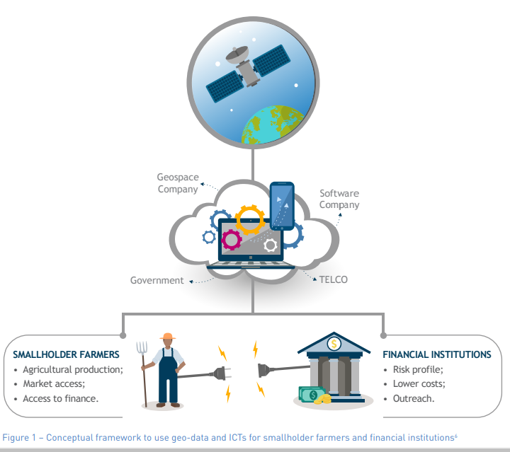
ENABLERS IN DEALING WITH DATA CHALLENGES

Slide 4
DATA
Data definition:
Information, especially facts or numbers, collected to be examined and considered and used to help decision-making, or information in an electronic form that can be stored and used by a computer.Cambridge Dictionary
Challenges in data collection: are reported below under the following themes:
1) location,
2) health literacy and language of data collection instrument,
3) duration of data collection,
4) researcher fatigue, and
5) sensitive information.

Slide 5
SUPPLY DATA CHALLENGES
There are three critical challenges providers face in regards to supply-side data:
There is a limited number of efforts aggregating data;
Those that are aggregating data, often fail to provide enough level of detail for it to be valuable
Providers themselves are often unwilling to share data publicly on their business model given competitive market risks

Slide 6
CHALLENGES RELATED TO DEMAND SIDE DATA IN FI
Making the data usable for a given audience in order to;
To effectively provide financial solutions for a given segment of customers.
Providers must gather and analyze data to understand who their target customer is and how to better serve them.
The collector of such data has a great influence on how the data will be presented, availed and managed.

Slide 7
IMPACT DATA
Research institutions and think-tanks tend to play a heavy role in gathering and sharing impact related data.
However, smaller on-the-ground organizations often lack the resources to implement impact measurement activities at scale, particularly rigorous impact evaluations.
Few organizations are aggregating and collecting sector-wide evidence to compare impact evidence across different institution types.

Slide 8
Thank You/ MURAKOZE/ MERCI.
Questions and suggestions are welcome.

